Slide 1
Introduction or Abstract
Results and Discussion
Goal and Objectives
Methodology
Conclusion

Slide 2
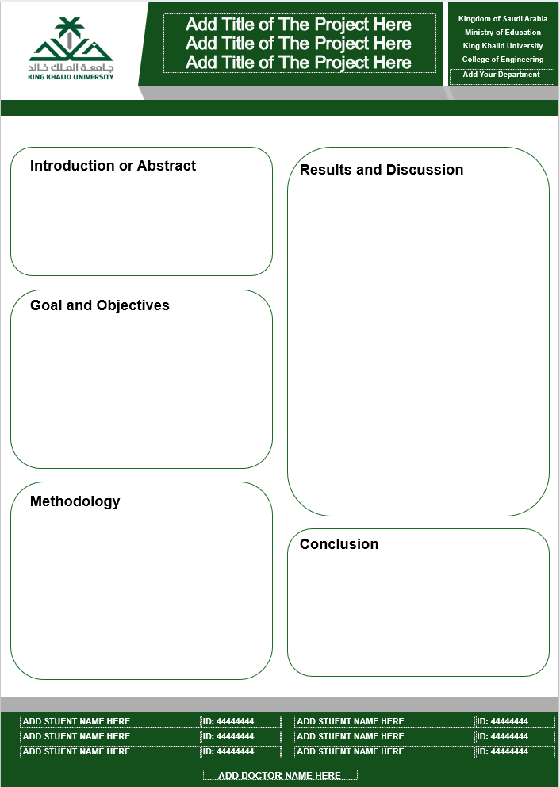
Font Size for A1 Poster
Font Style: Times New Roman
Heading: 44+
Body text: 24+
Caption: 16+
A1 size
H: 841mm
W:594 mm

